Slide 1
R&D Committee Workshop Series:
Initial Review and Approval of Exempt Research (Part 2) – Capstone Case
Dial in (Main): (213) 929-4212
Dial in (Alt): (646) 307-1722
Access Code: 655-737-312
Slides in “Handout” Tab
Soundia Duche, MA, MS C. Karen Jeans, PhD
Chief, Education & Training Director, Regulatory Affairs
ORPP&E ORPP&E
April 9, 2020

Slide 2
Objectives
Identify and apply some of the key evaluations required by the IRB and R&D Committee through evaluation of an exempt human subjects study requiring limited IRB review.

Slide 3

Typical Day in the Research Office

Slide 4

Investigators Come to the Research Office to Submit a Proposal For Review

Slide 5
The Traditional “Ideal” Model for Intake and Triaging of Research Proposals
Research Application Materials Received
Administrative Review (Quality Review)
Not Complete – Return to Investigator
Complete
Proceed to
Pre-Review to Determine Review Type
Assigned to Reviewers in Consultation with Chair

Slide 6
Determining the Appropriate Regulatory Pathway for Review
Review all details of the project
Address questions in the following order:
  Is it research?
  Is it human subjects research?
  Is the study exempt from the Common Rule?
  Is my facility engaged in human subjects research?
  Is the study eligible for expedited review?

Slide 7
Study Description - Background
Veterans with painful musculoskeletal disorders (MSD) like rheumatoid arthritis are often prescribed narcotics such as opioids to manage pain.
Prolonged use of the opioids prescribed to treat MSD carry the potential for eventual misuse and addiction.
The proposed study seeks to test a new type of screening assessment tool (questionnaire) completed by patients to improve clinical decision-making by health care providers for the care of Veterans who suffer from MSD and have been prescribed opioids for pain management.
The screening assessment tool is called the Pain Management Early Assessment Indicator (PMEAI).

Slide 8
Study Description – Study Aims
The aims of the proposed study stated in the materials sent by the investigators are to:
  Determine whether the PMEAI (the new screening assessment tool) can be implemented successfully in VA healthcare facilities, and
  Evaluate whether use of the PMEAI by healthcare providers at the VA Facility accurately predicts the development of opioid addiction and other associated negative outcomes among Veterans who are taking medications for pain management.

Slide 9
Study Description –Study Procedures
The PMEAI consists of both written questionnaires and telephone or in-person interviews. The Investigators will ask consented Veterans and their confidants or caregivers to complete written questionnaires and to participate in interviews with the research team every six months for 2 years.
The survey and interviews will ask questions about the Veteran subjects’ current and past mental, physical, and emotional health; prescribed medications; cigarette use; diet; and sociodemographic information.
The Investigators will also obtain information from the Veteran subjects’ VHA Health Record throughout the study to help validate information obtained from the subjects and record information about medications and medical conditions.

Slide 10
Determining the Appropriate Regulatory Pathway for Review
Review all details of the project
Address questions in the following order:
  Is it research?
  Is it human subjects research?
  Is the study exempt from the Common Rule?
  Is my facility engaged in human subjects research?
  Is the study eligible for expedited review?

Slide 11
Non-Research Quality Assurance/Quality Improvement or Research?
The aims of the proposed study stated in the materials sent by the investigators are to:
  Determine whether the PMEAI (the new screening assessment tool) can be implemented successfully in VA healthcare facilities, and
  Evaluate whether use of the PMEAI by healthcare providers at the VA Facility accurately predicts the development of opioid addiction and other associated negative outcomes among Veterans who are taking medications for pain management.

Slide 12
Research vs. Non-Research:
Tip: Three Questions to Make an Initial Assessment
Research (Common Rule) | Quality Improvement/Quality Assurance
Is it a systematic investigation designed to develop or contribute to generalizable knowledge? | Is it a systematic investigation designed to improve, based on existing evidence, a practice or process within a particular institution (or agency) or ensure it confirms to existing norms?
Is the activity mandated? Research activities are usually not associated with a mandated “requirement”, although as a Federal agency, VA has Congressionally mandated research. | Is the activity mandated? Mandated activities (such as a mandate to assess a hand washing practice of a healthcare facility to evaluate reduction of infections) is not research.
Are the findings expected to bring about an immediate change? Immediate change is not associated with most research activities. | Are the findings expected to bring about an immediate change? QI/QA is expected to directly affect institutional practice and result in immediate change (if there is a positive finding).

Slide 13
Research or Not Research?
It is Research

Slide 14
Determining the Appropriate Regulatory Pathway for Review
Review all details of the project
Address questions in the following order:
  Is it research?
  Is it human subjects research?
  Is the study exempt from the Common Rule?
  Is my facility engaged in human subjects research?
  Is the study eligible for expedited review?

Slide 15
Human Subject Definition
A human subject is a living individual about whom an investigator (whether professional or student) conducts research, and:
Obtains information or biospecimens through intervention or interaction with the individual, and uses, studies, or analyzes the information or biospecimens; or
Obtains, uses, studies, analyzes, or generates identifiable private information or identifiable biospecimens.
VHA Directive 1200.05 paragraph 3m.

Slide 16

Research Involving Human Subjects?

Slide 17
Poll #1: Who are the research subjects?
Veterans
Confidants/Caregivers
Providers
All of the Above

Slide 18
Recall Study Description and Procedures
The PMEAI consists of both written questionnaires and telephone or in-person interviews. The Investigators will ask consented Veterans and their confidants or caregivers to complete written questionnaires and to participate in interviews with the research team every six months for 2 years.

Slide 19
Poll #1: Who are the research subjects?
Veterans☑
Confidants/Caregivers☑
Providers
All of the Above

Slide 20
Determining the Appropriate Regulatory Pathway for Review
Review all details of the project
Address questions in the following order:
  Is it research?
  Is it human subjects research?
  Is the study exempt from the Common Rule?
  Is my facility engaged in human subjects research?
  Is the study eligible for expedited review?

Slide 21
Exempt or Non-Exempt Human Subject Regulatory Review Pathway?
The proposed study involves the collection of identifiable information from subjects’ medical records and the administration of surveys and interviews.

Slide 22
Eligible Exempt and Expedited Categories for the Proposed Human Subjects Study
Exempt Category | Expedited Category
Exempt category 2: Research involving educational tests, surveys, interviews, or observation of public behavior | Expedited category 7: Research on individual or group characteristics or behavior or research employing surveys, interviews, oral history, focus groups, program evaluation, human factors evaluation, or quality assurance methodologies
Exempt category 4: Secondary research using identifiable private information or identifiable biospecimens | Expedited category 5: Research involving materials (data, documents, records, or specimens) that have been collected or will be collected solely for non-research purposes (such as medical treatment or diagnosis).

Slide 23
Where Is the Option for Research being Both Exempt and Non-Exempt Because of the 2018 Requirements (the Revised Common Rule)?

Slide 24
Tips for Consideration when the Proposed Research Could be Approved as Exempt Research or Non-Exempt Human Subjects Research
The intent of the revision of the Common Rule (the 2018 Requirements) was to remove IRB oversight from certain types of minimal risk human subjects research activities.
A VA human subjects research activity cannot be approved by an IRB, the VA R&D Committee, or another entity as both exempt and non-exempt; it is an either one or the other.
Some IRBs are not willing to approve human subjects research activities as non-exempt if the proposed research is exempt under the 2018 Requirements even though the research could be approved as non-exempt human subjects research.
Some institutions are not willing to exempt human subjects research if the proposed research can be approved as non-exempt research.
Communication with IRBs is critical, including during the memorandum of understanding or IRB reliance agreement process.

Slide 25
Decision Made to Exempt - Poll #2:
Who can Make an Exempt Determination?
A member of a research-related committee
The R&D Coordinator
The IRB Administrator or staff
Any of the above (if trained)

Slide 26
Decision Made to Exempt - Poll #2:
Who can Make an Exempt Determination?
A member of a research-related committee
The R&D Coordinator
The IRB Administrator or staff
Any of the above (if trained)☑

Slide 27
Who Can Make Exempt Determinations for VA Research?
IRB Chair
Experienced IRB Member
  Past or Present
Qualified administrative staff with expertise in applying human research exempt regulations
  SOPs should define who makes exempt determinations for your institution
    Although not required, an appointment letter can be used to designate exempt determination officials
  SOPs should define required qualifications and training
An investigator may not self-certify that their study is exempt
Notes:
Exempt determinations may be made by the IRB Chair, an experienced IRB member, or qualified administrative staff with expertise in applying human research exempt regulations (VHA Directive 1200.05 paragraph 10b).

Slide 28
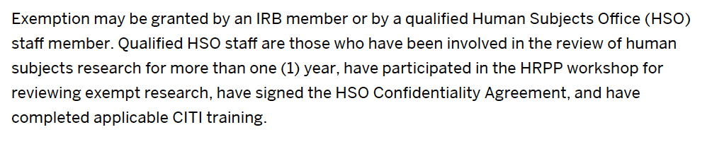
Sample Standard Operating Procedure: Exempt Determination Officials
Source: Indiana University: https://research.iu.edu/policies/human-subjects-irb/exempt-research.html

Slide 29
Which Exempt Categories Apply?
The proposed study involves the collection of identifiable information from subjects’ medical records and the administration of surveys and interviews.
  Possibly Exempt Category 4
The study team will be asking research subjects to complete surveys and be interviewed about the Veteran’s mental, physical, and emotional health and current and prior opioid use.
  Possibly Exempt Category 2
Exempt Determination Official wants to focus on Exempt Category 2 because she/he is unclear whether the study meets that category

Slide 30
Full Regulatory Text:
Exempt Category 2 (38 CFR 16.104(d)(2))
Research that only includes interactions involving educational tests (cognitive, diagnostic, aptitude, achievement), survey procedures, interview procedures, or observation of public behavior (including visual or auditory recording) if at least one of the following criteria is met:
(i) The information obtained is recorded by the investigator in such a manner that the identity of the human subjects cannot readily be ascertained, directly or through identifiers linked to the subjects;
(ii) Any disclosure of the human subjects' responses outside the research would not reasonably place the subjects at risk of criminal or civil liability or be damaging to the subjects' financial standing, employability, educational advancement, or reputation; or
(iii) The information obtained is recorded by the investigator in such a manner that the identity of the human subjects can readily be ascertained, directly or through identifiers linked to the subjects, and an IRB conducts a limited IRB review to make the determination required by § 16.111(a)(7).

Slide 31
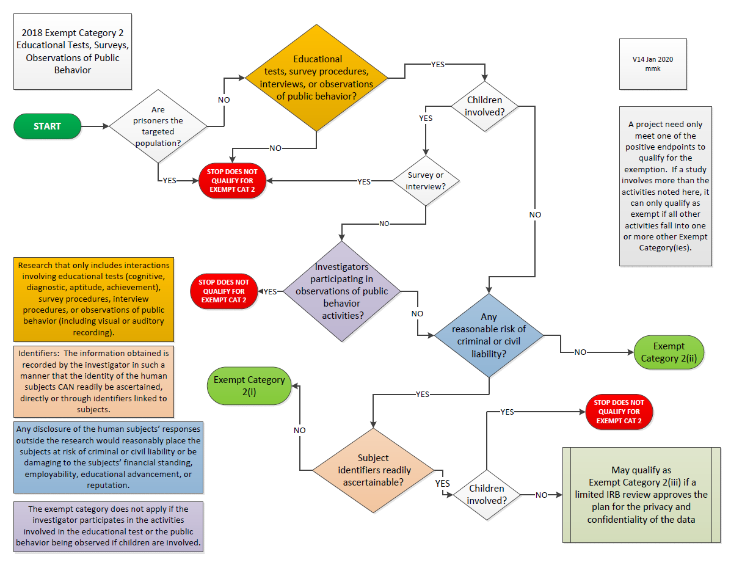

Slide 32
Exemption Determination Official Decides the Activity Requires Limited IRB Review
Do You Agree?

Slide 33
Poll #3: Does the Study Require Limited IRB Review?
Yes
B. No

Slide 34
Recall Study Description and Procedures
The proposed study seeks to test a new type of screening assessment tool (questionnaire) completed by patients to improve clinical decision-making by health care providers for the care of Veterans who suffer from MSD and have been prescribed opioids for pain management.
The survey and interviews will ask questions about the Veteran subjects’ current and past mental, physical, and emotional health; prescribed medications; cigarette use; diet; and sociodemographic information.
The Investigators will also obtain information from the Veteran subjects’ VHA Health Record throughout the study to help validate information obtained from the subjects and record information about medications and medical conditions.

Slide 35
Poll #3: Does the Study Require Limited IRB Review?
Yes ☑
B. No

Slide 36
Exemption Determination Official Agrees with You: The Proposed Research Requires Limited IRB Review
The exempt determination official decides that the proposed study meets exempt category 2(iii) requiring limited IRB review.
  Limited IRB Review is only used for research activities in Exemption categories 2(iii); 3(i)(c); 7; and 8.
  Must be done by the IRB.
  Can be conducted by Expedited Review.
  IRB is not required to evaluate the proposed study according to all of the §.111 IRB approval criteria, but there is an IRB approval for the limited IRB review.
  For Exemption 2(iii), the IRB must ensure that adequate provisions exist to protect the privacy of subjects and maintain the confidentiality of their data.

Slide 37
IRB is Sent the Proposed Research to Conduct a Limited IRB Review
The study is sent to the IRB for limited IRB review to determine whether there are adequate provisions to protect the privacy of subjects and to maintain the confidentiality of the data in accordance with 38 CFR 16.111(a)(7).

Slide 38
Limited IRB Review Considerations:
Exempt Category 2(iii)
The IRB’s evaluation of the §.111(a)(7) criteria for an exempt study is no different than when it evaluates a non-exempt study.
For this proposed research, the IRB may consider, but not be limited to, the following:
How will subjects be recruited?
How will information be collected?
How will subject’s privacy be protected during the completion of the surveys and the conduct of the interviews?
How will the subject’s identifiable information be handled, stored, and disseminated?
Will the information conveyed by the confidant or caregiver will be shared with the Veteran, and vice-versa?
Should a Certificate of Confidentiality be requested?

Slide 39
Are Exempt Studies also Exempt from HIPAA requirements?
No.

Slide 40
Documents Sent to the R&D Committee
Following limited IRB review, the IRB sends its limited IRB approval documentation to the R&D committee for review and approval.
The R&D Committee receives the following documents:
  Complete protocol packet, including surveys and interview questions
  HIPAA authorization form (VA Form 10-0493)
  Documentation that limited IRB review occurred
  Exempt Determination Letter

Slide 41
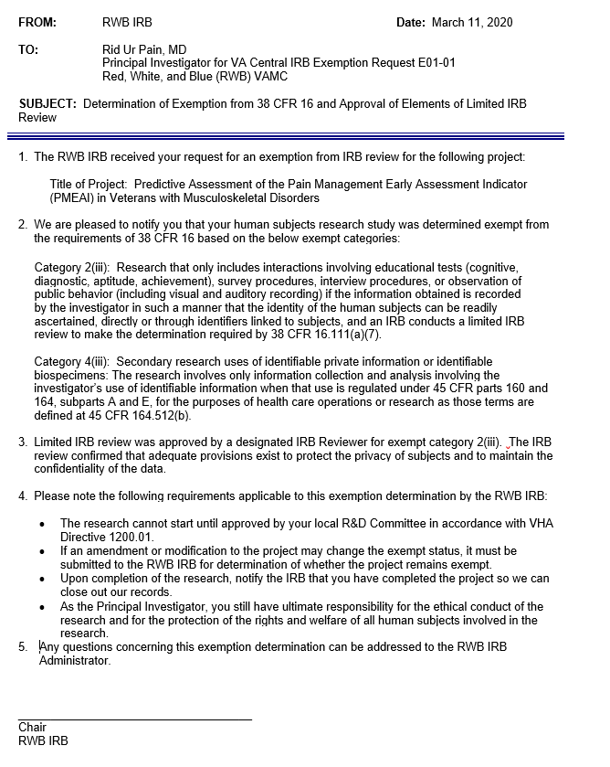
Sample Exempt Determination Letter

Slide 42
R&D Committee Review:
Designated Review
The R&D Committee Administrator assigns the protocol to one of the R&D Committee members for designated review.
The Chair, R&D Committee or a voting member designated by the Chair may approve exempt human subjects research protocols and protocols approved by expedited review by the IRB.
(VHA Directive 1200.01 paragraph 9e(4))

Slide 43
R&D Committee Review:
Designated Review (cont.)
Can be done by one voting member of the R&D Committee.
An exempt study is not required by ORD policy to be approved by the convened R&D Committee.
If a study qualifies for approval by the R&D designated review process and the R&D Committee is the sole oversight committee of the study modifications to the approved study and continuing reviews can also be reviewed and approved by designated review.

Slide 44
Activities that can be Approved by Designated Review Process:
VHA Directive 1200.01, Paragraph 9.e.
(1) Minor changes to a protocol required by the R&D Committee, following full board review.
(2) Final approval for protocols approved contingent on the full approval of a subcommittee if the subcommittee had not required major changes (as defined in local SOPs) to the protocol since the R&D Committee conducted its review.
(3) Final approval for protocols approved contingent upon completion of the PO and ISSO review.
(4) Exempt human subject research protocols and protocols approved by expedited review by the IRB.
(5) Single patient expanded access protocols approved by the IRB Chair or another appropriate IRB voting member.
(6) Protocols that do not involve human subjects, biosafety level (BSL-3) or higher containment, use of select agents or non-exempt quantities of select toxins, United States Department of Agriculture (USDA)-regulated animal species, or any animal research involving more than momentary pain or distress to animals.

Slide 45

The Designated Reviewer is Ready to Approve the Research, and then She/He Remembers an ORPP&E Presentation ----
Non-Veteran Subjects? Separate Approval? Convened R&D Committee?

Slide 46
Non-Veterans are Subjects in the Proposed Study
The designated reviewer remembers that the study involves the enrollment of confidants and caregivers.
The investigator must justify including non-Veterans and the R&D Committee must review the justification and provide specific approval for recruitment of non-Veterans.
VHA policy allows non-Veterans to be recruited for studies that will generally benefit Veterans and their well-being but would not include Veterans as subjects.
Non-Veterans may only be enrolled into a VA-research study involving VA outpatient or inpatient treatment when there are insufficient Veteran patients suitable for the study.
VHA Directive 1200.01 paragraph 13

Slide 47
Considerations when Approving the Enrollment of Non-Veterans
Considerations include, but are not limited to:
Evaluation of the justification: Are non-Veterans proposed to be included in a study recruiting Veterans because of convenience?
Funding source (or lack of funding source) for interventional studies: Medical dollars cannot pay for research-related injuries to non-Veterans participating in VA research. If the study is funded by industry, for example, the CRADAs usually contain legal requirements for the sponsors to assume all research-related injury costs to any VA subject.
ORD funded with waiver approval of Non-Veterans: If the study is funded by ORD, ORD must approve a non-Veterans waiver for the inclusion of non-Veterans and is assuming the costs associated with research-related injuries to non-Veterans in the specific study

Slide 48
Exempt Research Policy Requirement Specific to VA: Ensuring Subjects Participating in Exempt Research are Provided Required Information
While reviewing the exempt study, the designated reviewer notes that the Investigator did not include any materials that will be provided to prospective subjects to inform them that they are being asked to participate in a research activity as required by ORD policy in VHA Directive 1200.05, paragraph 10c.

Slide 49
Exempt Research Policy Requirement Specific to VA: Ensuring Subjects Participating in Exempt Research are Provided Required Information
For studies involving interactions with subjects or obtaining information by educational tests, survey or interview procedures, or behavioral interventions, Prospective subjects must be provided the following information, as applicable, in writing or orally:
  The activity is research;
  Participation is voluntary;
  Permission to participate can be withdrawn;
  Permission for use of data can be withdrawn for exempt research activities involving the collection and use of identifiable data; and
  Contact information for the VA Investigator.
  VHA Directive 1200.05, Paragraph 12.c.

Slide 50
Poll #4:
What Additional Information is Needed?
What information should the designated reviewer request from the investigator?
A. Document or script describing how subjects will be informed that they are being asked to volunteer for a research study and can withdraw their participation and/or data for research purposes at any time.
B. Copies of study recruitment ads that will be posted in the hospital
C. If recording subjects, information provided to subjects informing them that they will be recorded.
D. A copy of the informed consent form or a waiver of informed consent

Slide 51
Poll #4:
What Additional Information is Needed?
What information should the designated reviewer request from the investigator?
A. Document or script describing how subjects will be informed that they are being asked to volunteer for a research study and can withdraw their participation and/or data for research purposes at any time.☑
B. Copies of study recruitment ads that will be posted in the hospital.☑
C. If recording subjects, information provided to subjects informing them that they will be recorded.☑
D. A copy of the informed consent form or a waiver of informed consent
Notes:
Correct answer is A, B, and C if recordings are going to be done. Discussion will address why D is not required for exempt research.

Slide 52
Approvals Prior to Study-Initiation
The following approvals are required before final R&D Committee approval is granted:
  Privacy Officer Review
  Information Security Officer Review
Before the Investigator can begin the research, he/she must receive notification from the ACOS/R&D.

Slide 53
Key Takeaways
Multiple responsibilities exist when reviewing exempt research
Multiple parties are involved in different aspects of the review, to include the IRB, R&D Committee, Exempt Determination Official, Privacy Officer, Information Security Officer, and Privacy Board, when applicable
Important to understand the differences in responsibilities, particularly when the same individual may serve multiple roles (e.g. exempt determination official is also a member of the IRB or R&D Committee)

Slide 54
The Exemption Determination Official for this Exempt Case Study Is Ready for Questions

Slide 55

Questions

Slide 56
Contact Information
Soundia Duche, MA, MS C. Karen Jeans, PhD, CCRN, CIP
Chief, Education and Training Director, Regulatory Affairs
ORPP&E ORPP&E
Office of Research and Development Office of Research and Development
Washington, DC Washington, DC
Soundia.Duche@va.gov c.karen.jeans@va.gov

Slide 57
Availability of Recording
A recording of this session and the associated handouts will be available on ORPP&E’s Education and Training website approximately one week post-webinar
An archive of all ORPP&E webinars can be found here: https://www.research.va.gov/programs/orppe/education/webinars/archives.cfm

Slide 58
Important Links
Revised Common Rule (published January 19, 2017)
  Pages 7259 to 7274 contain the Text of the Final Rule
VHA Directive 1200.05
VHA Directive 1200.01
ORD Policies and Guidance Documents
ORPP&E Cyberseminars

